Slide 1
Dairy Farm Shop Management System
Yogeshwar
1928

Slide 2
INTRODUCTION
A Shop selling the milk and the secondary product of milk. The software is manage there stocks .
Control the stocks
Make Reports
Make invoice

Slide 3
OBJCTIVE
Help for milk seller to keep all records
Give the various report for user
Make small shops Being the digital

Slide 4
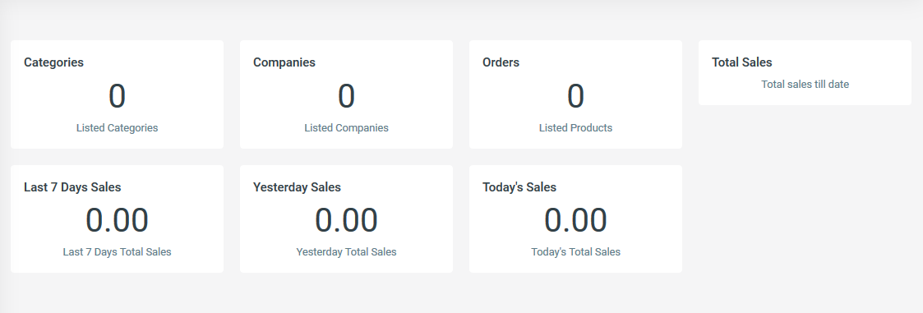
Reports

Slide 5
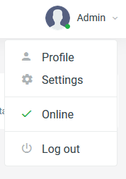
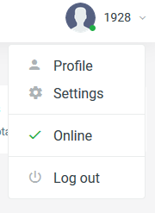
Users
User A
User B

Slide 6
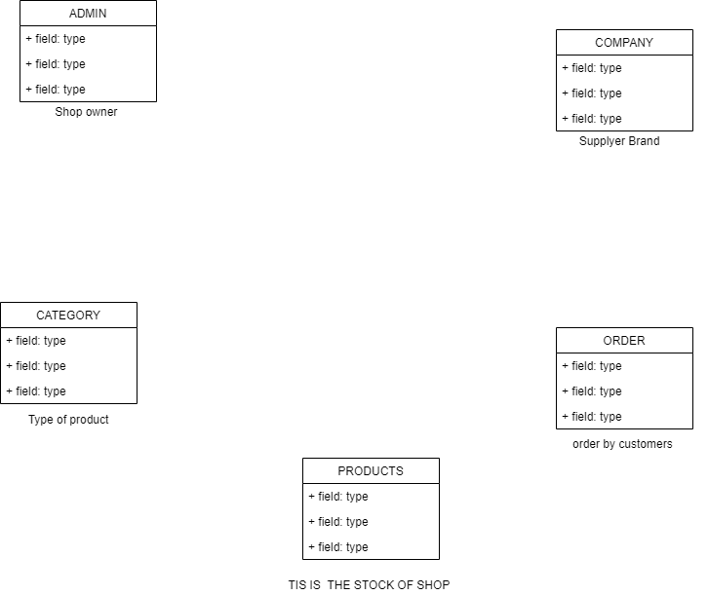

Slide 7
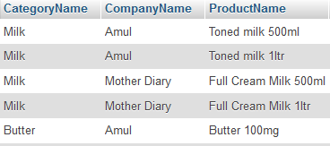
IDEA
Milk
Category
Goa Dairy
Company
Customer Taniya
Orders

Slide 8
Tables
Table Products
# id int
Categoryname varchar
CampanyName varchar
ProductName varchar
Price int
Posting date time
Table Company
# Id int
CompanyName varchar
PostinngDate timestamp
Table Orders
# id int
productID int
Quantity int
InvoiceNumber int
CustomerName varchar
CustomerContact int
PaymentMode varchar
Invoice Date timestamp

Slide 9
Tables
Table of admin
# ID int
Admin name varchar
Username char
Mobile number int
Email varchar
Password varchar
Table Category
# ID int
categoryName varchar
CategoryCode varchar
PostingDate timestamp

Slide 10
THANK YOU !!

